Slide 1
iFlyQuiet
Community Engagement Materials
Notes:
This slide presentation provides materials for helicopter operators and pilots to engage the community on the issue of helicopter noise.
The content may be used as-is or in may be re-packaged to suit individual situations and venues.
The notes accompanying each slide provide suggested explanatory text.

Slide 2
Section 1:
Introduction
Notes:
This Section presents an overview of the iFlyQuiet and Fly Neighborly initiatives

Slide 3
What is iFlyQuiet?
Initiative to address helicopter noise issues through community outreach and engagement
    Establish a consistent dialogue with communities affected by helicopter noise
    Educate communities about steps operators are taking to reduce noise
Notes:
The iFlyQuiet initiative was created to address helicopter noise issues in a consistent and ongoing manner through community outreach and engagement.
As part of iFlyQuiet, Helicopter Association International (HAI) along with the FAA and helicopter operators, are working to establish more consistent dialogue with communities that may be affected by helicopter noise and educate the public about the steps operators are taking to reduce noise.
An inherent part of iFlyQuiet community outreach should be a commitment to Fly Neighborly noise abatement procedures.

Slide 4
What is Fly Neighborly?
Fly Neighborly: Holistic approach to mitigating helicopter noise issues
  Noise abatement flight procedures
  Route planning
  Community outreach
Based on 40+ years of helicopter noise manufacturer and government research
Formal training programs available through FAA-WINGS and HAI
Online training for FAA-WINGS credit was created by Volpe on behalf of the FAA. https://go.usa.gov/xQPCW
Notes:
Fly Neighborly is a voluntary noise reduction program applying a holistic approach to the mitigation of helicopter noise issues. It employs noise abatement flight procedures, judicious route planning and effective community outreach to foster better relationships between communities and helicopter operators.
The program dates back to the early 1980’s when the first Fly Neighborly Guidelines were developed and published.
The current program is based on 40+ years of helicopter noise testing by manufacturers and government research organizations.
Formal training programs for pilots and operators are available through both FAA-WINGS and HAI.

Slide 5
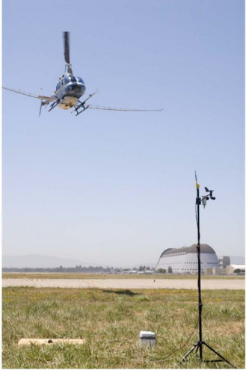
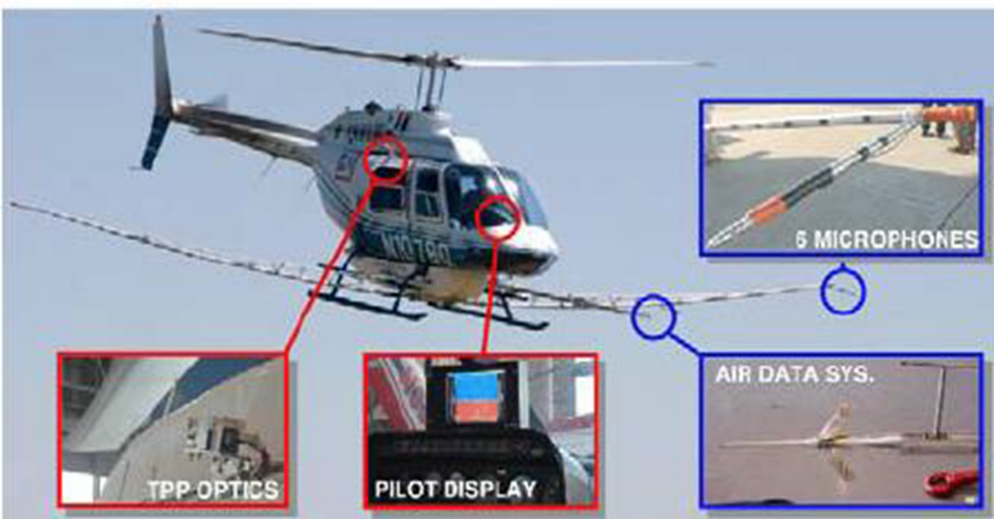
Fly Neighborly Research
Scientific, quantitative approach to measuring sound emissions
Quantify acoustics for different maneuver conditions
Notes:
The Fly Neighborly research was conducted with the goal of understanding the acoustics of different helicopter maneuvering conditions – using a scientific and quantitative approach

Slide 6
Who supports iFlyQuiet and Fly Neighborly?
HAI’s Fly Neighborly Environmental Committee
  Membership comprised of U.S. and international public and private organizations
Additional support from
  Federal Aviation Administration (FAA)
  National Aeronautics and Space Administration (NASA)
  US DOT’s Volpe National Transportation Systems Center (Volpe)
  Department of Defense (DOD)
  Vertical Flight Society (VFS)
  Academia (Pennsylvania State University)
Notes:
Fly Neighborly is supported by the HAI Fly Neighborly Environmental Committee, with individual members from government, academia and helicopter operator organizations, both within the US and abroad.
The committee and program also have the support of the FAA, NASA, DOD, Volpe Center, the Vertical Flight Society, and Academic Institutions such as Penn State.

Slide 7
Section 2:
Sound Measurement and Perception
Notes:
This Section presents some basic information on sound level measurement and perception

Slide 8
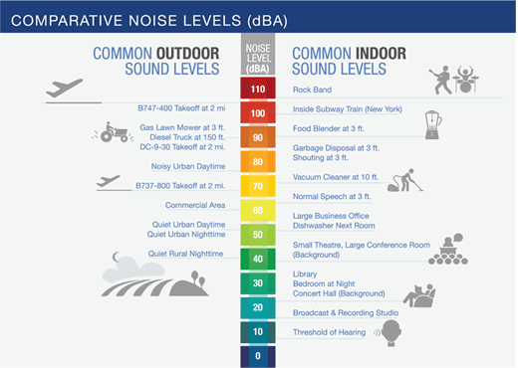
Sound Levels and Decibels
Sound: Measured in decibels (dB) on a logarithmic scale
A-weighting – developed to account for how humans perceive sound
Source https://www.faa.gov/regulations_policies/policy_guidance/noise/basics/
Notes:
Sound is commonly measured and reported units of a decibel – abbreviated dB
The decibel scale is a logarithmic scale, it works in a different way to the scale on a ruler, which is a linear scale.
The logarithmic decibel scale goes up in powers of ten: every increase of 10dB on the scale is equivalent to a 10-fold increase in sound intensity.
That means a sound of 50dB is 10 times more intense than a sound of 40dB
This slide shows some common sound indoor and outdoor sound levels.

Slide 9
Perception of Sound
Change in Sound Level | Perceived Change to Human Ear
± 1 dB | Not Perceptible
± 3 dB | Threshold of Perception
± 5 dB | Obvious Change
± 10 dB | Twice / Half as Loud
± 20 dB | Fourfold or ¼ as Loud
Notes:
But how does all this translate into "loudness"—what we actually feel about the volume of a sound?
In general, we can say that a 3 dB increase or decrease in sound would be just noticeable, whereas a 10dB increase would feel roughly like a doubling in loudness.

Slide 10
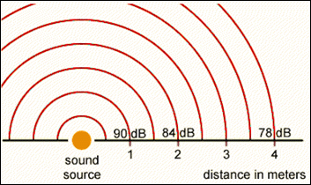
Sound Propagation
Sound level decreases as the distance from the source increases
Contributing factors
  Distance divergence (spreading)
  Atmospheric absorption
Sound Pressure Levels in a Free Field
Source: OSHA Technical Manual, Section III Chapter 5
Notes:
Sound propagation describes what happens to sound as it travels
We all know inherently that a sound will be quieter if you move away from the source. This is due to a number of factors, primarily distance divergence and to a lesser degree, atmospheric absorption.
To figure out how much a sound will decrease as it travels due to divergance, we apply the inverse square law.
Simply put, the sound level will decrease 6 dB, each time the distance from the source is doubled.
The figure illustrates a source that produces a sound level of 90 dB at a distance of 1 meter. The sound level will be 84 dB at 2 meters, 78 dB at 4 meters, and so forth. This principle holds true regardless of the units used to measure distance.
This is why flying higher is one most basic fly neighborly principles.

Slide 11
Noise Metrics
Noise metric: Quantity that measures effect of noise on environment- federal agencies commonly use 4 noise metrics:
  Maximum Noise Level (L_{max}): Measure of the highest sound level occurring during single event
  Sound Exposure Level (SEL): Total sound energy of single event
  Equivalent Sound Level (L_{eq}): Average sound level of all events over specific time period
  Day-Night Average Sound Level (DNL): Average sound level over 24 hours, with a penalty to nighttime events
Source: PSU Noisequest https://www.noisequest.psu.edu/noisebasics-noisemodels.html
Notes:
PSU Noise quest maintains a library of helpful videos which illustrate these concepts: https://www.noisequest.psu.edu/noisebasics-noisemodels.html

Slide 12
Section 3:
Helicopter Noise Basics
Notes:
This Section presents some basic information on helicopter noise generation

Slide 13
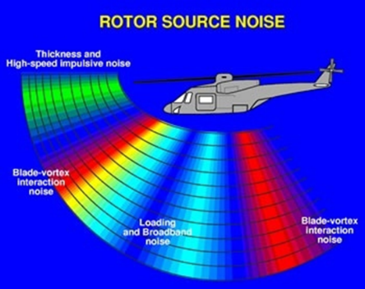
Helicopter Noise Emissions
Helicopter noise is complex and comprised of multiple noise sources
Different operating conditions cause different sound characteristics, quality, loudness, and directivity
4 primary types of noise:
  Thickness and High Speed Impulsive (HSI) noise
  Blade Vortex Interaction (BVI) noise
  Loading and Broadband noise
  Tail Rotor Interaction (TRI) noise
Source: K Brentner, PSU
Notes:
Helicopters emit unique acoustic signatures, where noise is repetitive and cyclical. This graphic illustrates the different kinds of helicopter noise and the directions in which the noise propagates from the aircraft.
Helicopter noise characteristics can vary significantly under different operating conditions. Helicopter noise can sometimes be impulsive and characterized by repetitive sharp sounds, like pops, or “blade slap.”
Helicopter noise signatures can sometimes be reduced during the development of a helicopter design.

Slide 14
High Speed Impulsive (HSI) Noise
Higher rotor speed and forward airspeed compound
Can travel over very long distances
Pilots cannot hear this in the aircraft
Notes:
High Speed Impulsive, or HSI noise is caused when a helicopter with high RPM is flown at high airspeeds, which can cause impulsive shock waves to radiate forward from the advancing-side blades.
HSI noise can travel over very long distances. On larger aircraft, especially those with older blade designs, HSI noise is a concern when operating at high air speeds.

Slide 15
Blade Vortex Interaction (BVI) Noise
Created when rotor blades pass through or close to the wake of the preceding blades
Impulsive and directional
Can travel long distances
Most people will find BVI annoying
Notes:
Blade Vortex Interaction or BVI noise is created as a result of a rotor blade passing through or close to the wake structure that is shed off of a preceding blade.
BVI noise is impulsive, and directional - sometimes referred to as blade slap. Most people will find it annoying.
In many cases, BVI noise is not heard by the pilot in the cockpit.
BVI noise often occurs during approach conditions and can occur during maneuvering flight such as turns and decelerating level flight.

Slide 16
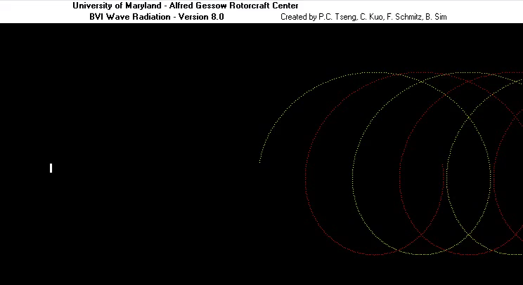
BVI Visualization
Notes:
This is a simplified depiction of BVI.
In this demonstration, you can see how BVI noise is created. You can see as the rotor completes its revolution, a rotor blade hits or comes into close proximity to a vortex that was created by a preceding blade.

Slide 17
Section 4:
Fly Neighborly Recommendations
Notes:
This section covers some of the recommended procedures that may be incorporated into a Fly Neighborly program. Pilots are continually working to implement these recommendations in a safe and effective manner.

Slide 18
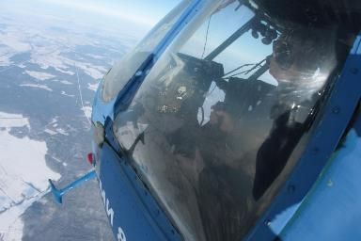
Noise Abatement in Flight - Safety Comes First!
As always, safe flight given priority over noise
Noise abatement profiles require
  Technical proficiency
  Training
  Mission planning / execution
Notes:
In every instance maintaining a safe flight path must be given priority over the noise profile. Successful integration of noise abatement profiles requires the pilot to be technically proficient and adequately trained, and focused on mission planning and execution.

Slide 19

Fly Neighborly Considerations
Key Considerations
    Safety
    Flyability
    Passenger Acceptability
    Duration / Operational Costs
    Routing Requirements
What’s in the Fly Neighborly Toolkit
    Routing Changes
    Altitude
    Airspeed
    Departure: Rate-of-Climb
    Arrival: Rate-of-Descent
Notes:
There are several key considerations a pilot must to address when modifying a flight to reduce noise, including flyability, passenger acceptability, operational costs, routing and, last but not least, safety. Typically, these considerations represent constraints on possible noise abatement procedures.
For reducing noise on approach to a location, the primary tools in the Fly Neighborly toolkit are routing changes, altitude, airspeed, rate of climb and rate of descent

Slide 20
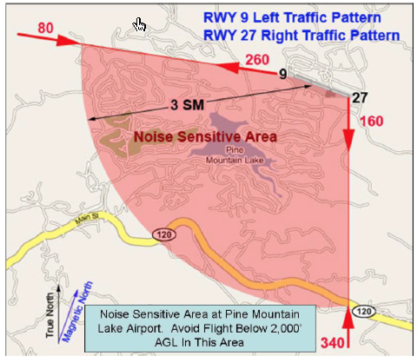
Fly Neighborly - Routing
Routing should be considered in pre-flight planning
Avoid noise-sensitive areas
Notes:
Pre-flight planning can help pilots integrate noise abatement considerations, when practical and safe. Once all factors of flight have been considered, pilots may be able to use recommended traffic patterns to avoid noise-sensitive areas.
This diagram shows this for Pine Mountain Lake Airport in Groveland, CA. The diagram shows specific flight paths to take to reduce noise in the area and also recommends that pilots avoid flight below 2000 feet in this area.

Slide 21
Fly Neighborly - Altitude Considerations
Doubling of height decreases sound level directly under flight path by 6–7 dB(A)
Tripling the height reduces sound levels by approximately 10 dB(A)
But -
  Flying higher not always
  safe or practical
  Increases affected area
Notes:
One key suggestion for reducing noise is to fly higher – at a Fly Neighborly Altitude.
A doubling of height or distance decreases the sound level directly under the flight path by 6–7 dB(A). Tripling the height or distance reduces the sound levels by approximately 10 dB(A).

Slide 22
Fly Neighborly - Speed Considerations
Lower airspeed generally reduces noise level
But –
  Lower airspeed increases overflight duration
Notes:
Community annoyance is typically a function of both the level and the duration of a noise event. Slower airspeeds can prove annoying even if BVI noise is reduced, and often higher airspeeds are preferred both acoustically and operationally.

Slide 23
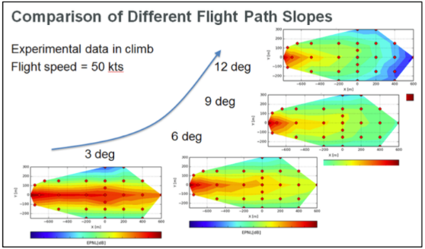
Fly Neighborly - Departures
Steeper take-offs reduce the area affected
But
  Pilots must balance
  safety risks
Notes:
The colored plots displayed here depict measured noise data for different climb angles for a constant speed 50 knot departure. The lower left image is for a shallower 3 degree climb and the other images are for 6, 9 and 12 degree departures. One can see the dramatic reduction in the high noise areas for increasing departure angles, indicated in red. Steeper take-offs greatly reduce the noise footprint, even with higher power.

Slide 24
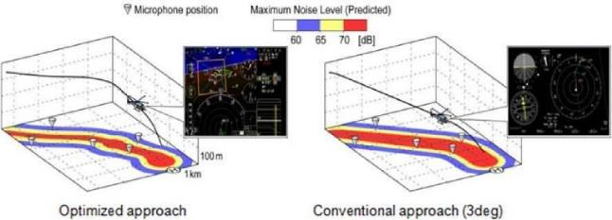
Noise During Arrival
Optimized arrivals can reduce noise footprint
Steeper rate of descent results in less noise exposure
Staying higher longer reduces noise
Notes:
During arrival operations, the approach phase is normally the helicopter’s loudest. Though power requirements are very low compared to cruise flight or take-off, BVI noise is dominant.
The images displayed illustrate the difference between an optimized arrival profile (left) and a conventional 3 degree arrival profile (right). The flight trajectories are depicted as the black lines. The colored ground footprints depict the maximum noise levels. You can see that the delayed initiation of descent and steeper angle on the left, results in less noise exposure, indicated by smaller red areas, on the ground than the 3 degree approach path. Staying higher longer will reduce noise.

Slide 25
Section 5:
Fly Neighborly in Action
Notes:
This section contains demonstrations of the noise abatement techniques in the previous section

Slide 26
Link to Demonstrations
The videos in the following slides will require an internet connection for playback. They may be accessed via YouTube at:
https://www.youtube.com/playlist?list=PLm_7Y91JGJbvtzBPAuHMHOjX3riok_B2K
Notes:
https://www.youtube.com/playlist?list=PLm_7Y91JGJbvtzBPAuHMHOjX3riok_B2K

Slide 27
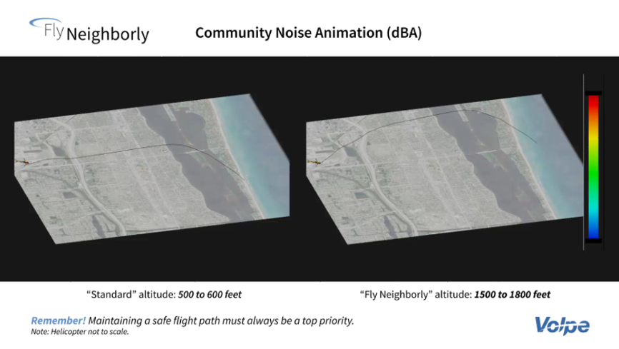

Notes:
This Community noise animation shows the noise footprint for flights at different altitudes: the standard altitude of 500 to 600 feet and the “Fly Neighborly” altitude of 1500 to 1800 feet. The projection is a bird’s eye view of the aircraft on its flight path, viewed from an oblique angle.
At the fly neighborly altitude, the aircraft’s noise footprint may spread out but it’s at much reduced levels.

Slide 28
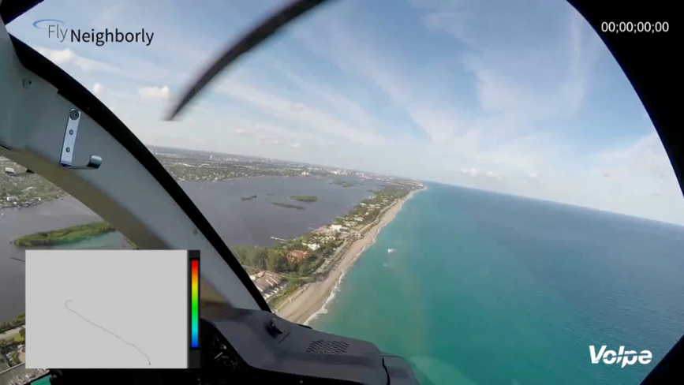
Notes:
This visualization depicts an approach into Palm Beach International from the South. One can see the noise footprint on the community. The inset in the lower left shows a synchronized eagle eye view of the footprint. The pilot is limited to a 600 ft. maximum flight altitude over the shoreline. The aircraft is decelerated to 100 knots over the bay to allow for a lower speed steady flight over the densely populated community.
The pilot executes a steady state right turn on final approach to minimize noise emission, before the final deceleration during the last portion of the turn into the airfield.

Slide 29
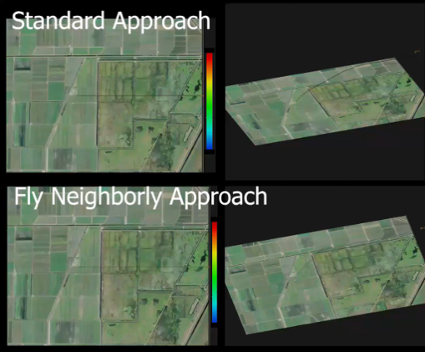
Noise Visualization: Standard vs. Fly Neighborly Approach
Standard
Fly Neighborly
Notes:
This demonstration shows the affected area and noise footprint for two different types of approach – a standard approach with shallow descent against a fly neighborly approach with a steeper descent angle.

Slide 30
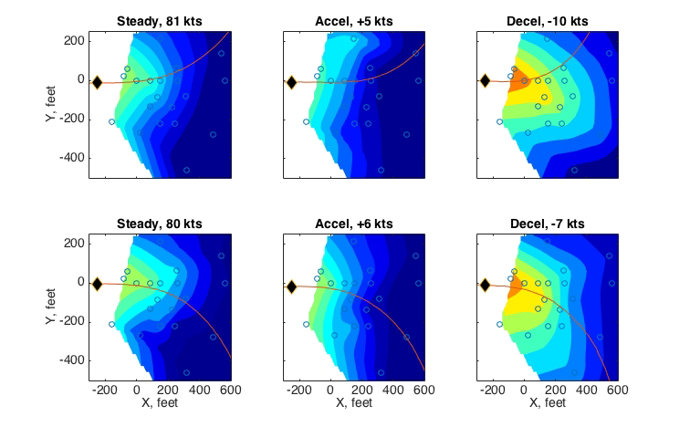
Bell 430 Left and Right Turns
95
90
85
80
75
70
i
ii
iii
dBA
Courtesy: NASA
iv
v
vi
Notes:
This visualization compares the left and right hand turn noise footprints for steady state, accelerating, and decelerating flight.
Left hand turns are in the top row, and right hand turns are in the bottom row.
Here you can see an acoustic visualization of the ground footprints. When making a left turn, noise is projected to the right. When making a right turn, noise is projected slightly to the left.
In general turning AWAY from the advancing blade is quieter than turning into it.
Pilots may consider this when designing optimal routes

Slide 31
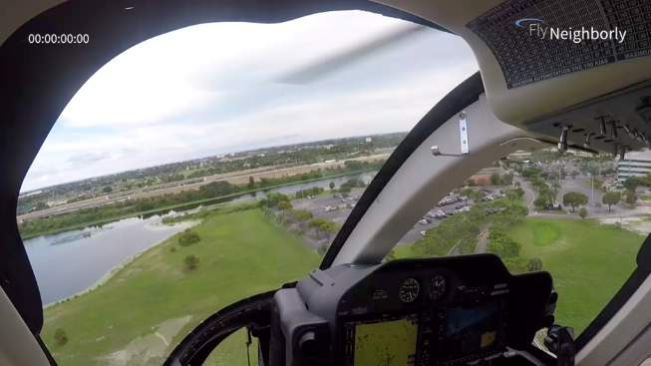
Fly Neighborly Departure
Notes:
In this video you can see how, during right turns, the noise is projected off to the left.
Something to note in this video is that the noise scale in these Bell 407 animations are slightly different from the graphics shown previously for the Bell 430. Here red represents 70 dB and blue represents 45 dB, but the concepts are the same.
This animation can help a pilot visually improve situational awareness of the helicopter noise footprint and learn to inherently apply fly neighborly techniques in daily operations.
In this video, you can see that as the pilot turns out on the water, he is trying to keep the red noise area over the water until the aircraft crosses down over the south end of Palm Beach.

Slide 32
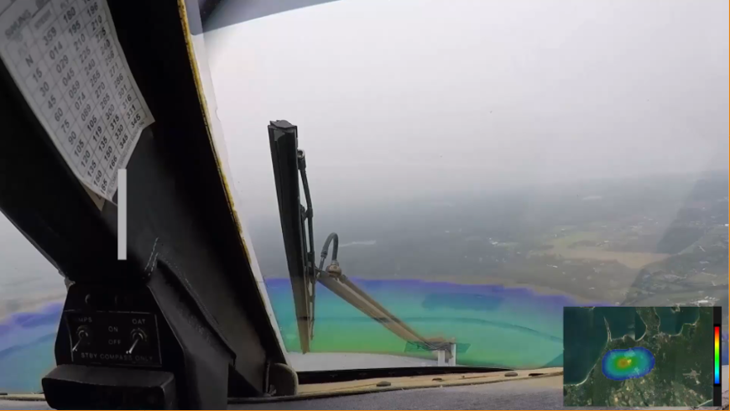
Notes:
This is an S-76 approach to East Hampton NY. As you watch the acoustic footprint overlaid on the view out the cockpit window, you will also hear recorded sounds in the community from this flight as the vehicle passes over four recording stations. This shows the differences in the sound of the noise received on the ground during the different phases of flight.

Slide 33
Section 6:
Fly Neighborly Limitations
Notes:
This section contains a review of the considerations and issues pilots encounter when implementing a Fly Neighborly program

Slide 34
Why Can’t Fly Neighborly Be Used Every Day?
Safety: Flying higher or with steeper climb descent rates may be unsafe in certain circumstances
Pilot workload: Procedures which require high pilot workload to execute are inherently unsafe
Air traffic: Nearby fixed-wing or helicopter traffic may preclude use of certain procedures
Weather: May affect air traffic patterns, flight ceilings and safety
Passenger comfort: G-forces
Re-routing may just move the noise problem

Slide 35
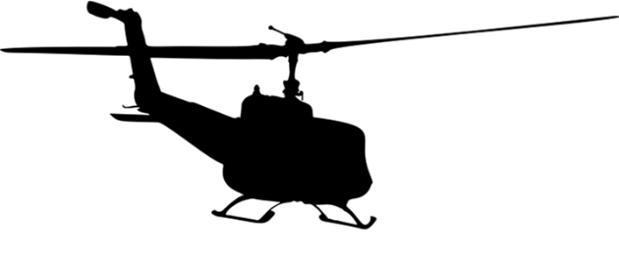
As always, fly safe out there!
Notes:
We hope you found this course both interesting and informative and that it will prove useful to you in addressing your noise issues. As always, fly safe out there.

