Slide 1

SBIR Common Fraud Schemes and Consequences
Department of Transportation, Office of Inspector General

Slide 2
Expectations
The purpose of this presentation is to educate SBIR stakeholders on fraud, waste, and abuse by highlighting common types of fraud found in the Small Business Innovation Research (SBIR) program, and to show what OIG looks for in support of investigations.

Slide 3
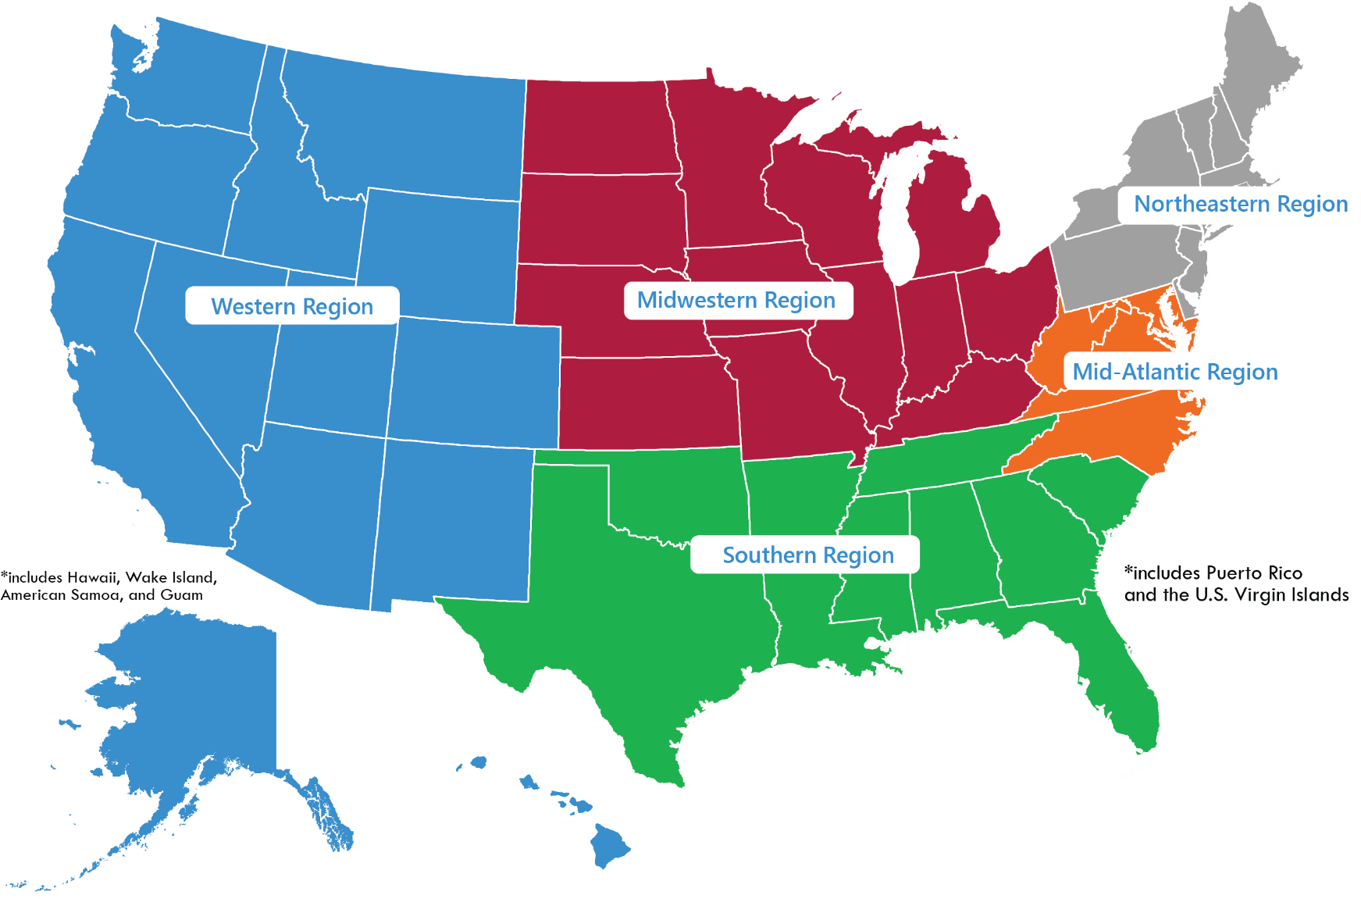
Investigative Regions

Slide 4
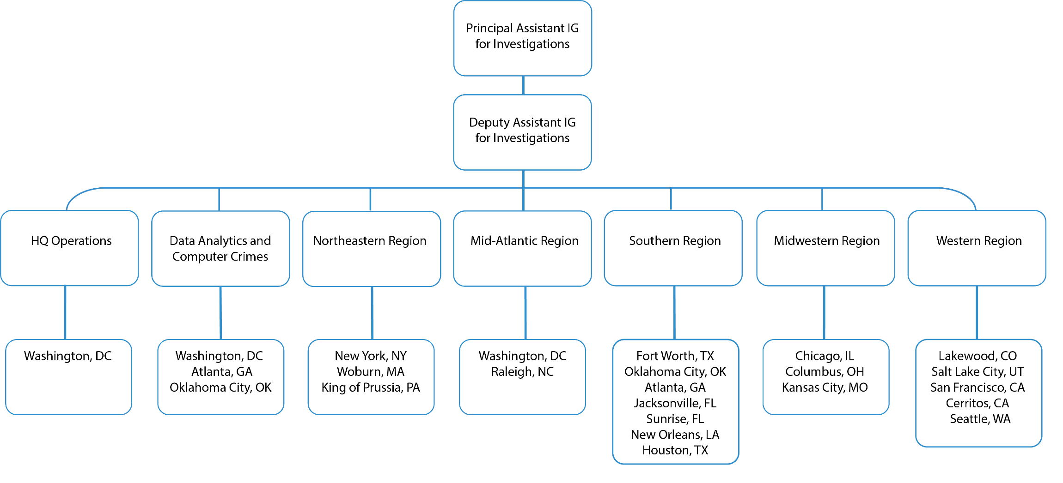
Office of Investigations

Slide 5
Office of Investigations
Conducts criminal, civil and administrative investigations of fraud and other allegations affecting DOT Operating Administrations, programs, contractors, grantees, and regulated entities.
Partners with Federal, State, and local law enforcement agencies and prosecutors.
DOT-OIG Investigative Resources
Special Agents with Federal law enforcement arrest authority
Investigative tools (subpoenas, search warrants, undercover operations, electronic monitoring)
Specialize in fraud investigations
Computer crime forensics unit

Slide 6
Office of Investigations
Transportation Safety
Procurement & Grant Fraud
Public Interest
Employee Integrity
Other Investigative Areas

Slide 7
Fraud Defined
  Fraud is described as any false representation about a material fact or any intentional deception designed to deprive the United States unlawfully of something of value or to secure from the United States a benefit, privilege, allowance, or consideration to which an individual or business is not entitled.”
  OIG does not prosecute innocent mistakes. Although the statute requires knowledge that the claim was false, the term “knowledge” includes “deliberate ignorance” or “reckless disregard for the truth.”

Slide 8
Please type your answer in the chat:
  Who can commit fraud?
  Government contractors
  Subcontractors
  Agency personnel
  All of the above
Notes:
Answer: D – all of the above

Slide 9
Where Does Fraud Occur?
Within the SBIR program, there are several points during the process where fraud can occur. They include, but are not limited to:
During the application process;
Within the proposal itself;
Award period of performance; and
Close-out

Slide 10
Four Main Types of Fraud
It is important to note that the presence of one or more indicators does not prove fraud, nor are the indicators shown all-inclusive for each of the schemes described.
Misrepresentations or factual omissions
Misrepresentation of expended funds
Misuse of award funds
Duplication of funds

Slide 11
Combatting Fraud
Misrepresentations or factual omissions
Submitting a plagiarized proposal or false certifications about research
Providing false information about the company and the principal investigator and their capabilities
Submitting inaccurate labor rates
Falsified letters of reference
Sham websites or emails

Slide 12

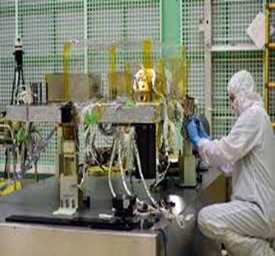

Real World Examples: Proposal Submission
Applicant uses a 4,500 square foot state of the art technical facility including three clean rooms, ten laser benches, and a variety of laboratories.

Slide 13
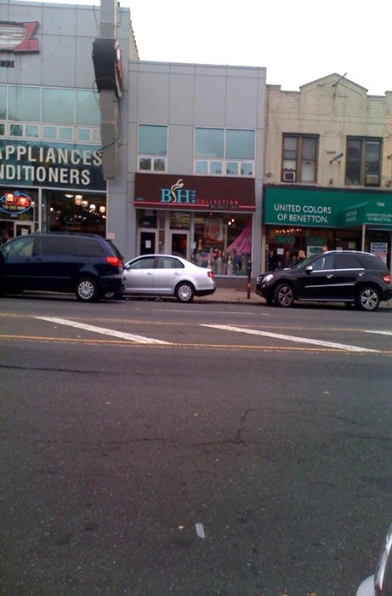
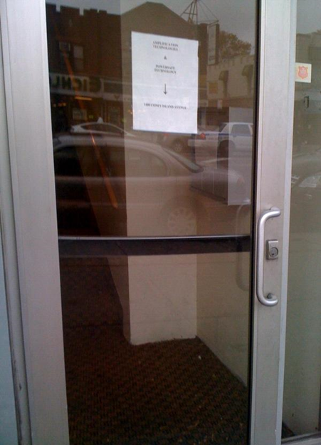
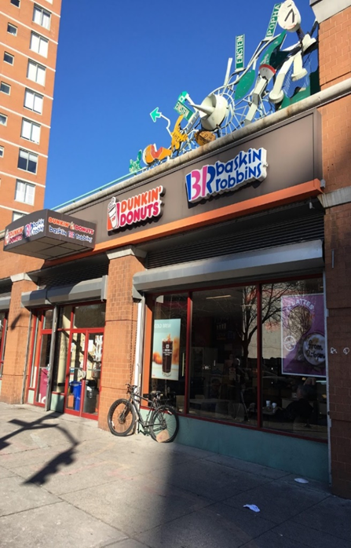
Real World Examples: Proposal Submission
Applicant actually worked out of a storefront in a shopping center.

Slide 14
Combatting Fraud
Misrepresentations of Expended Funds
Falsifying how funds were used – personal use or for any use other than the proposed activities
Misrepresenting work done and results achieved – plagiarized reports or falsely claiming work has been completed
Research recycling – using research performed under a previous contract or plagiarized results for an award funded by a different source

Slide 15
Combatting Fraud
Misuse of Award Funds
Using funds to pay for purchases other than funded research
Funneling SBIR funds to personal accounts - falsifying time sheets or payment to vendors to conceal the improper use

Slide 16
Combatting Fraud
Duplication of Funds
Receiving multiple SBIR awards from the same or different agencies to conduct the same research. This includes submitting identical deliverables for work that is supposed to be separate.

Slide 17
Combatting Fraud
Self-Dealing
Occurs when providing subcontracts to entities where the principal investigator or their family has financial interest, and failure to comply with applicable federal cost principles (reasonable, allowable and allocable).
A cost is reasonable if it is one a reasonable person would incur in the circumstances, after appropriate market research and price analysis.

Slide 18
Knowing the Rules
Which SBIR rules should you be particularly familiar with?
Duplicate or overlapping proposals may not be submitted to multiple agencies without full disclosure to all agencies.
Company must meet the Small Business Administration’s requirements for a small businesses, including being majority American-owned and have 500 employees or less.
The PI’s primary employment must be with the company during the contract period. The PI may not be employed full-time elsewhere.
Research and development must be performed in the United States.

Slide 19
Concerns About Foreign Influence
There is an increasing trend in the U.S. Government to view foreign collaborations with greater scrutiny; e.g. “foreign talent programs” or other foreign state-affiliated partnerships, particularly from countries perceived to be “of risk.”
Accepting money from multiple sources for essentially equivalent research is always a violation, regardless of where it comes from – disclosure is key; the more you share the better the relationship with your project manager. This is particularly notable with “angel investors” who are seeking to invest in small, unestablished entities with little or no promise of return.
Small business owners are encouraged to conduct due diligence and to “know your investor” practices to ensure they are not taking money from bad actors.

Slide 20
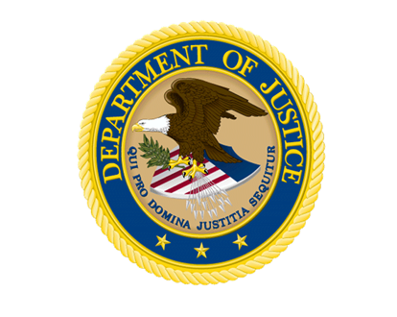


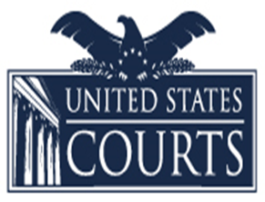

Consequences
What happens when are rules broken?
If you commit fraud or other wrongdoing in applying for or carrying out an SBIR award, OIG will investigate. Those who commit fraud are subject to administrative, civil and criminal action. Violations of civil or criminal law are referred to the Department of Justice (DOJ).

Slide 21
Consequences - Administrative
Government can terminate contracts tainted by fraud.
Government can debar the small business owner and/or employees. Debarment is typically 3 years, but can be longer.
Prohibition from receiving any federal contracts or working as a subcontractor on federal contracts.

Slide 22
Consequences - Civil
Although the statute requires knowledge that the claim was false, the term “knowledge” includes “deliberate ignorance” or “reckless disregard for the truth.”
Includes treble damages (3x actual) and a fine of up to $11,000 for each false claim.
False claims liability includes payments received when the Government relied upon false information in the SBIR contract proposal, in a certification of current cost or pricing data, in a request for payment or in progress reports.
Program Fraud Civil Remedies Act subjects anyone who knowingly makes or submits a false claim or statement to a civil penalty of not more than $7,000 for each false claim or statement as well as twice the amount of any payments made by the Agency.
Whistleblowers can receive up to 30% of an award for reporting fraud via the qui tam provision of the False Claims Act.

Slide 23
Consequences - Criminal
Providing false information to obtain an SBIR contract or about the work performed violates several criminal laws to include, but not limited to:
False Statements - punishable to 5 years in prison, forfeiture and $250,000 fine
Theft of Federal Property - punishable to 10 years in prison, forfeiture and $250,000 fine
Wire Fraud - punishable to 20 years in prison, forfeiture and $250,000 fine
False Claims - punishable by $250,000 fine for individuals and $500,000 fine for corporations
Criminal forfeiture – full amount of contract; personal assets can also be seized to satisfy forfeiture or fine.

Slide 24
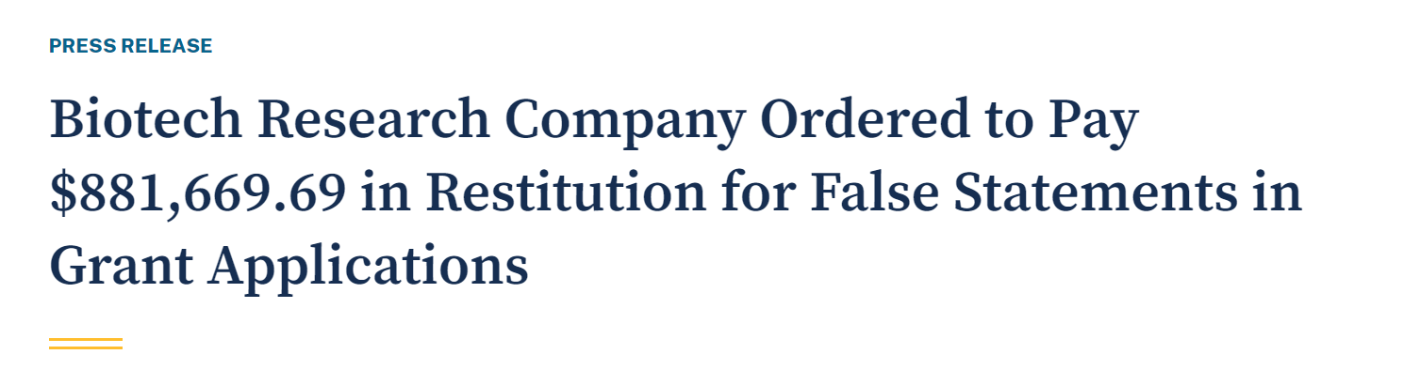
Investigations Case Study #1
Company made false statements to receive funding
Company submitted proposals to multiple agencies that contained misrepresentations regarding its eligibility to seek SBIR and/or STTR grant awards, as well as other material aspects of their project, including employees, budget, and recommenders.
Outcomes
Company pleaded guilty to two counts of false statements
$881,699 in restitution; 5-year probation

Slide 25
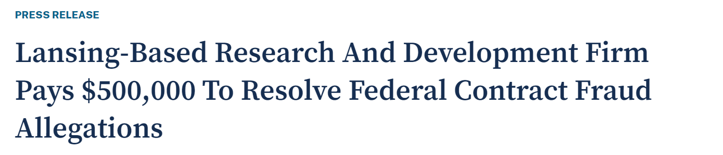
Investigations Case Study #2
Company violated the false claims act
Company concealed its use of underpaid foreign graduate students who were ineligible to work at the company due to visa restrictions, to obtain SBIR contracts.
Outcomes
2-year voluntary exclusion from federal contracting and financial assistance
$500,000 recovery

Slide 26
True or False
T/F: The presence of a red flag equals fraud.
T/F: Duplicative funding is a violation of federal law.
T/F: Award work must be completed in the United States.
T/F: Proper documentation is not required to spend funds on a contract if it was discussed in the proposal.

Slide 27
Do The Right Thing
The Government retains the right to examine the status of an SBIR contract at any time. This includes site visits; and requests for records including financial documents and timesheets.
Good record keeping will help eliminate suspicion and ensure successful status checks.
When in doubt, ask!

Slide 28
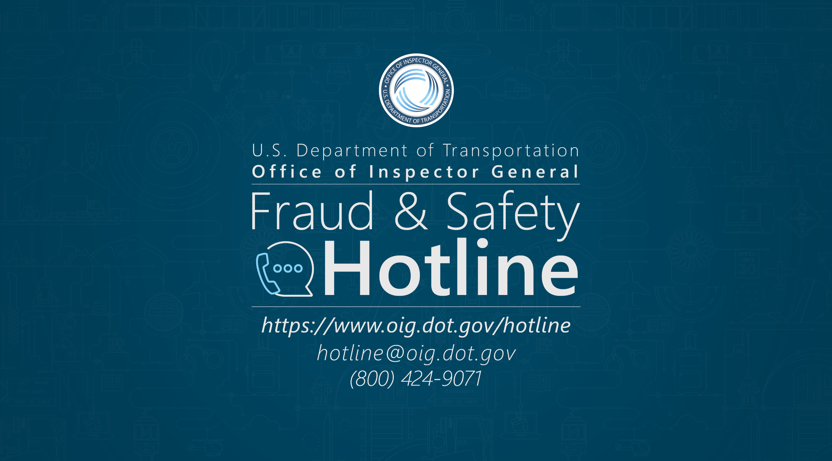
DOT Inspector General, 1200 New Jersey Ave SE, West Bldg. 7th Floor, Washington, DC 20590

Slide 29
Speakers
Jacquie Wente
Special Agent/Desk Officer
Jacquie.M.Wente@oig.dot.gov
(312) 287-2196
Maureen Weir
Special Agent/Desk Officer
Maureen.Weir@oig.dot.gov
(202) 366-4329
Omar Cantu
Special Agent/Desk Officer
Omar.Cantu@oig.dot.gov
(817) 978-3979

Slide 30


