Slide 1






Comparison of two community noise models applied to a NASA urban air mobility concept vehicle
Abstract ID 1650
Stephen A. Rizzi, NASA Langley, USA
Juliet A. Page, US DOT Volpe Center, USA
Rui Cheng, NIA, USA
internoise2021.org

Slide 2
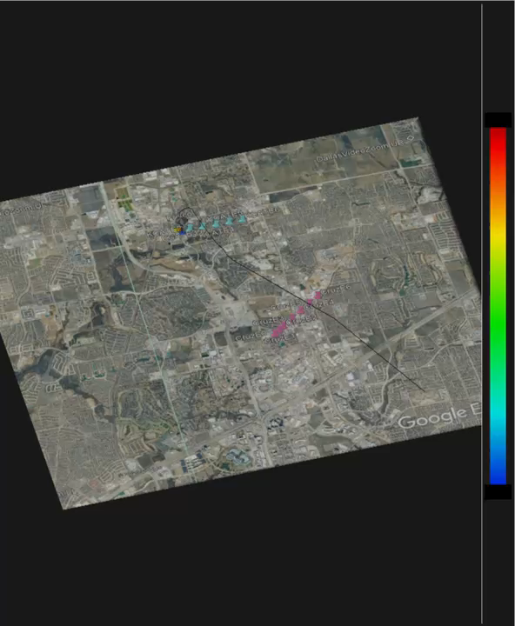

Departure Condition (3D View), 20 Hz 1/3-Octave Band, 40-70 dB
Opening Ceremony
Exhibition opens
Exhibition for 2+ days
Wednesday
Closing Ceremony
Next Congress Reception

Slide 3
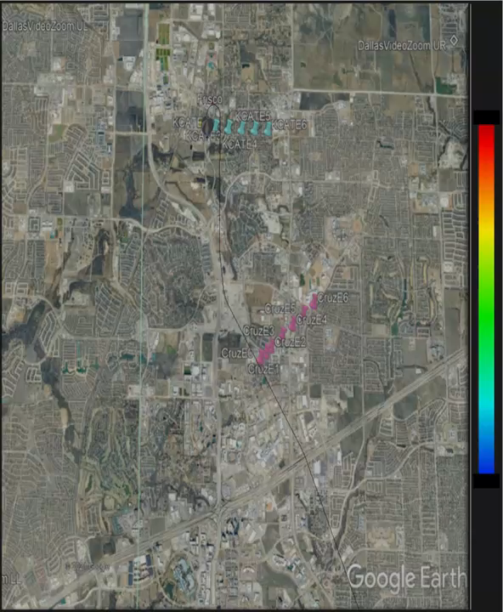
Departure Condition (Top View), 20 Hz 1/3-Octave Band, 40-70 dB
Opening Ceremony
Exhibition opens
Exhibition for 2+ days
Wednesday
Closing Ceremony
Next Congress Reception

Slide 4

Departure Condition (3D View), 100 Hz 1/3-Octave Band, 40-70 dB
Opening Ceremony
Exhibition opens
Exhibition for 2+ days
Wednesday
Closing Ceremony
Next Congress Reception

Slide 5

Departure Condition (Top View), 100 Hz 1/3-Octave Band, 40-70 dB
Opening Ceremony
Exhibition opens
Exhibition for 2+ days
Wednesday
Closing Ceremony
Next Congress Reception

Slide 6

Departure Condition (3D View), OASPL, 30-60 dBA
Opening Ceremony
Exhibition opens
Exhibition for 2+ days
Wednesday
Closing Ceremony
Next Congress Reception

Slide 7

Departure Condition (Top View), OASPL, 30-60 dBA
Opening Ceremony
Exhibition opens
Exhibition for 2+ days
Wednesday
Closing Ceremony
Next Congress Reception

Slide 8
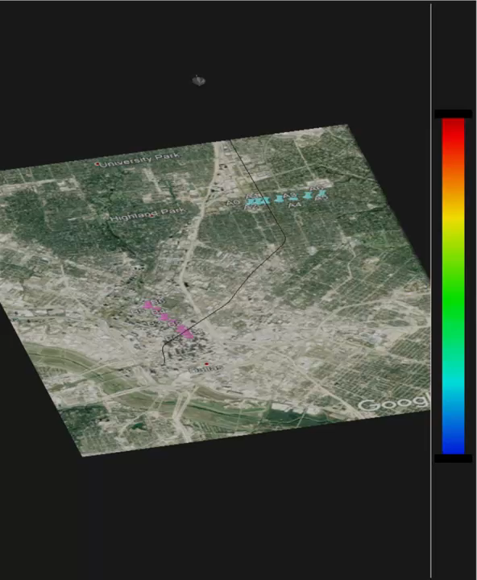
Approach Condition (3D View), 20 Hz 1/3-Octave Band, 40-70 dB
Opening Ceremony
Exhibition opens
Exhibition for 2+ days
Wednesday
Closing Ceremony
Next Congress Reception

Slide 9
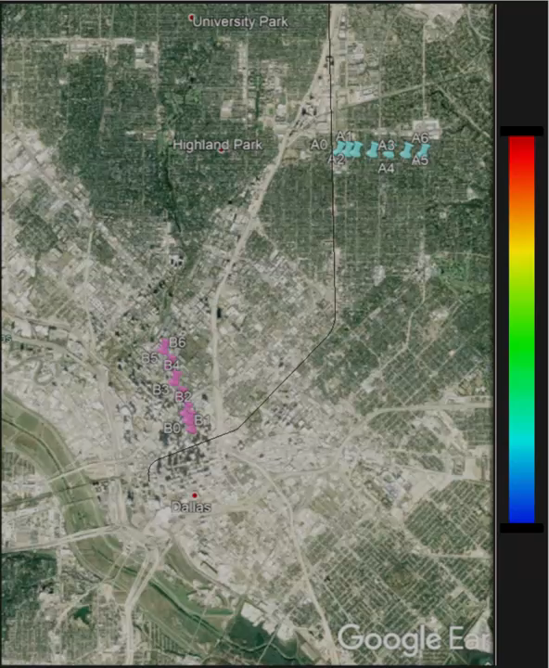
Approach Condition (Top View), 20 Hz 1/3-Octave Band, 40-70 dB
Opening Ceremony
Exhibition opens
Exhibition for 2+ days
Wednesday
Closing Ceremony
Next Congress Reception

Slide 10
Approach Condition (3D View), 100 Hz 1/3-Octave Band, 40-70 dB
Opening Ceremony
Exhibition opens
Exhibition for 2+ days
Wednesday
Closing Ceremony
Next Congress Reception

Slide 11
Approach Condition (Top View), 100 Hz 1/3-Octave Band, 40-70 dB
Opening Ceremony
Exhibition opens
Exhibition for 2+ days
Wednesday
Closing Ceremony
Next Congress Reception

Slide 12
Approach Condition (3D View), OASPL, 30-60 dBA
Opening Ceremony
Exhibition opens
Exhibition for 2+ days
Wednesday
Closing Ceremony
Next Congress Reception

Slide 13
Approach Condition (Top View), OASPL, 30-60 dBA
Opening Ceremony
Exhibition opens
Exhibition for 2+ days
Wednesday
Closing Ceremony
Next Congress Reception

